Slide 1
CASSEGRAIN TELESCOPE an Overview….
Submitted by
Sanjay R
2024PGPHPH10
course code – PH3206

Slide 2
TABLE OF CONTENT
Telescope and its types
Cassegrain reflecting Telescope
Construction of Cassegrain Telescope
Working of Cassegrain Telescope
Visual representation of a Cassegrain Telescope
Mathematical Representation
Family of Cassegrain Reflector
My Thoughts
Application
Images Captured by Cassegrain Telescope and its family
Conclusion
Reference

Slide 3
What is Telescope
An optical instrument used to see distant object like star,exoplanets and Space
It magnifies the things in the space and shows exact image
Types of Telescope
Optical Telescope
Reflecting Telescope
Refracting Telescope
Catadioptric Telescope

Slide 4
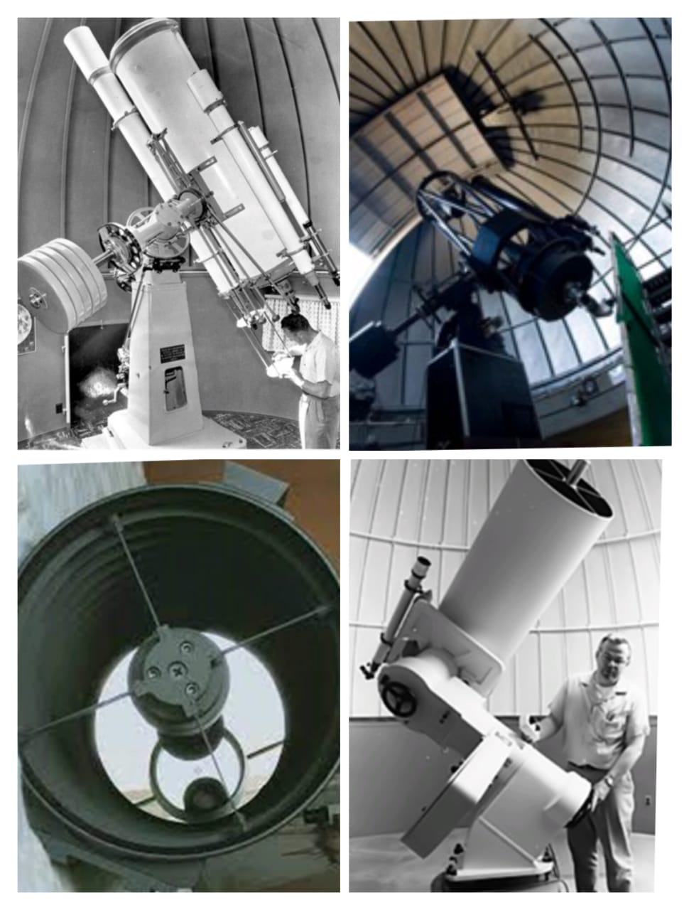
CASSEGRAIN Reflecting Telescope
The Cassegrain Telescope – Reflecting Telescope(uses primary & Secondary Mirrors)
Primary Mirror – huge parabolic concave mirror
Secondary Mirror – small hyperbolic convex mirror
Mechanism - folded light paths using a mirrors allows it to deliver long focal lengths without needing a physically long tube.
The Design was first introduced by Laurent Cassegrain in1672 so the telescope is named after his name

Slide 5
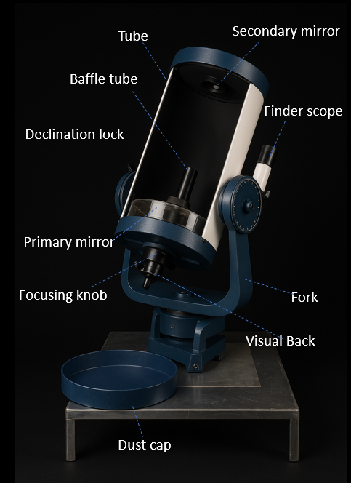
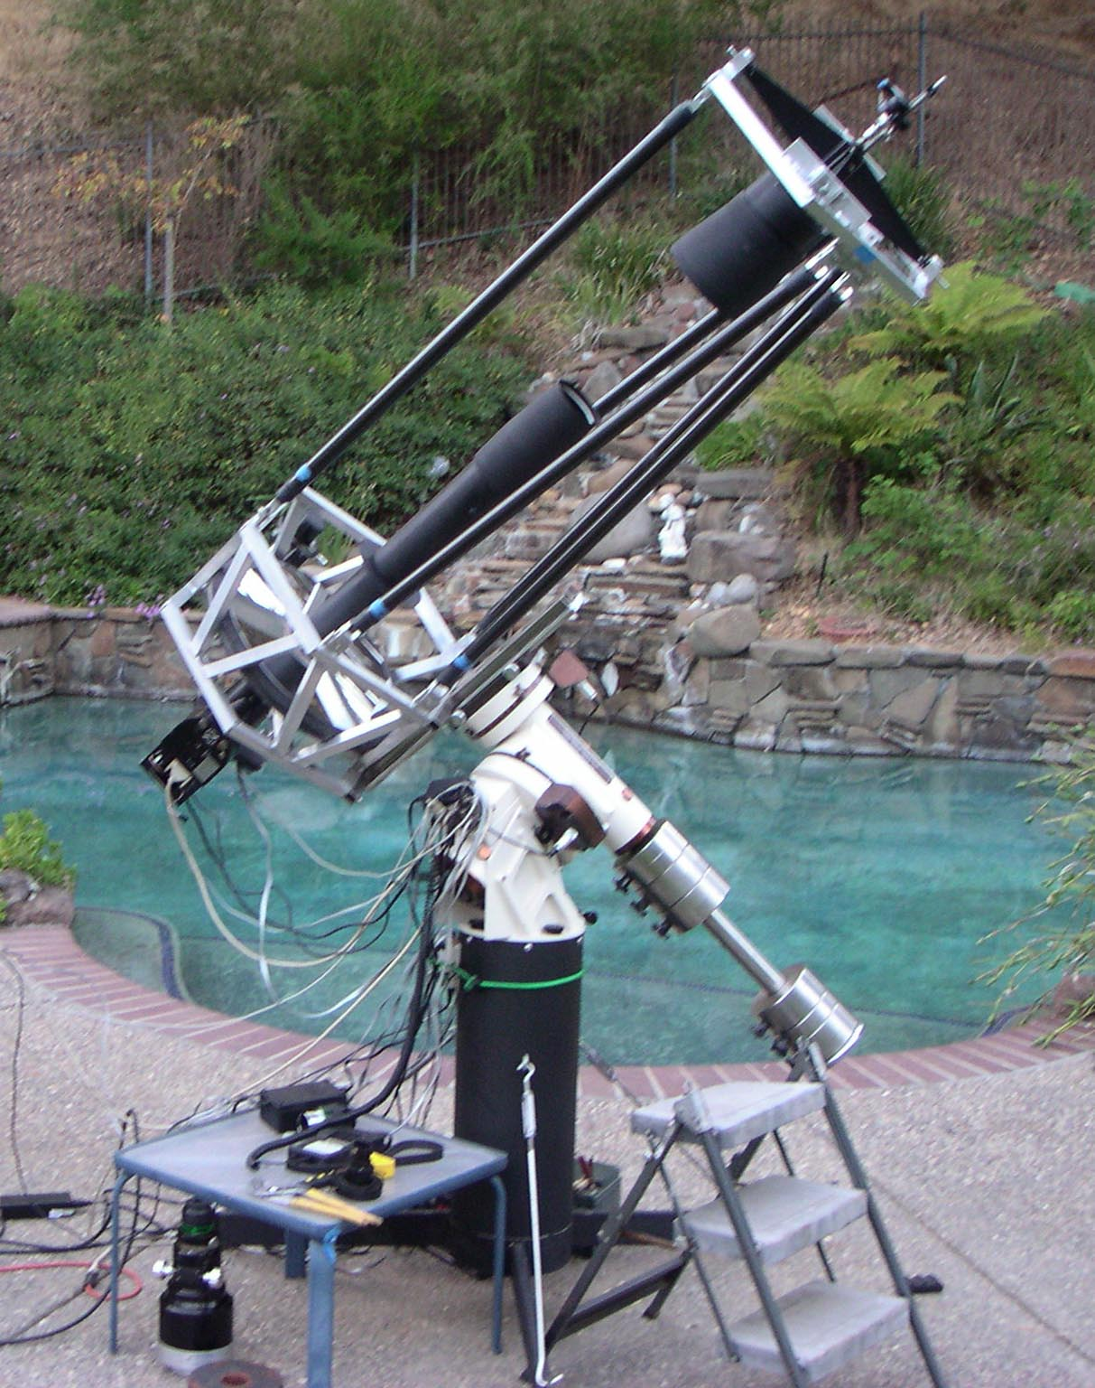
Construction
Primary mirror- at the bottom
Secondary mirror – just before the focal point of primary mirror
In a Cassegrain both mirrors are aligned in the optical axis
A primary mirror contains a hole in the center it permits the light to reach an eyepiece.
Eyepiece(Visual back) – magnifies the real image formed in the focus and visualizes
Baffle tube - blocking stary and off axis light and helps to maintain optical alignment
The outer covering - carbon fibre for its light weight and thermal stability

Slide 6
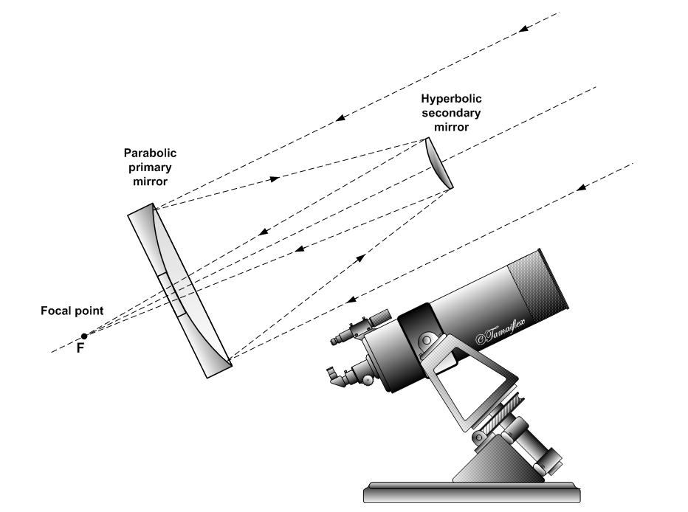
Working
Parallel(distant) light → Primary mirror → Secondary mirror → Hole in primary → Focal plane → eyepiece
Light from a distant object (like a star or planet) enters the front opening of the telescope.
The light is parallel as the object is at infinity.
The light hits the large concave primary mirror and starts to converge the light toward its focal point.
Before the light reaches the primary focal point, it hits the convex secondary mirror.
This hyperbolic mirror diverges the light slightly and reflects it back through a small hole in the center of the primary mirror.
The image is formed in the focal plane behind the primary mirror in the eyepiece

Slide 7
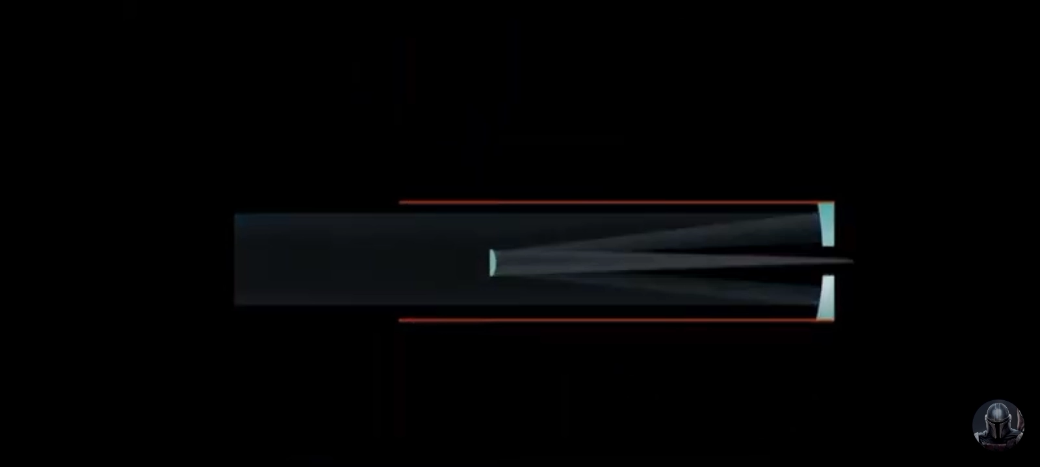
Visual representation of a Cassegrain Telescope

Slide 8
Mathematical Representation
Radius of Curvature of the primary mirror
R= -2DF/(F-B)=-2F/M
Radius of Curvature of the Secondary mirror
r= -2DB/(F-B-D)=-2B/(M-1)
Distance between two mirror
D = f(F-B)/(F+f)
Where
F – effective focal length of the system
B – The back focal length
f – focal length of primary mirror
M = (F-B)/D – Secondary magnification
The ratio of secondary mirror to the primary mirror in Cassegrain Telescope is = 3/10

Slide 9
Family of Cassegrain Reflector
Cassegrain Telescope
Schmidt-Cassegrain Telescope
Maksutov-Cassegrain Telescope
Ritchey-Chretien Telescope
Klevtsov-Cassegrain Telescope

Slide 10

My Thoughts
Primary & Secondary Mirror → Deformable Mirrors
Wave Front Sensor - Hartman Sack sensor(grid), Pyramid Sensor(pyramid) → Data Processing(control System) - Determine the shape → Actuators(Electrical → Mechanical ) Change the shape → corrected wave front
Piezoelectric Actuator(Ceramic) → Voltage(expands or contract)
Developing user friendly software
Growing Technology – Metasurface mirrors(thin Flat single film)-2D array of nanostructure(meta atoms)
SR Cassegrain Telescope

Slide 11
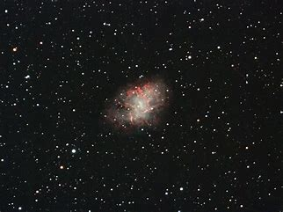
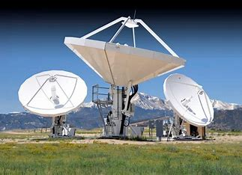
Applications
Observing celestial objects including the moon, planets, stars and deep sky objects
It is popular choice for both professional and amateur Astronomers
Cassegrain designs are also used in radio telescopes and radio antennas
It suits for a variety of observing tasks including planetary and lunar observations as
A more compact design, the ability to eliminate chromatic aberration, the potential for larger apertures and cost effectiveness shows it is much better than refracting telescopes

Slide 12
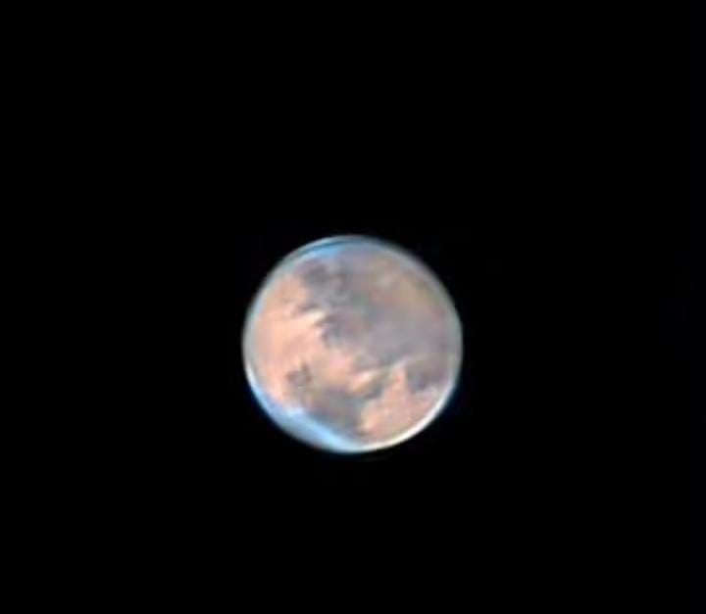
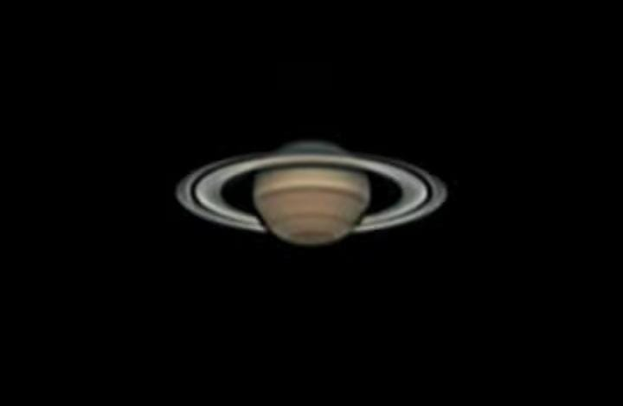
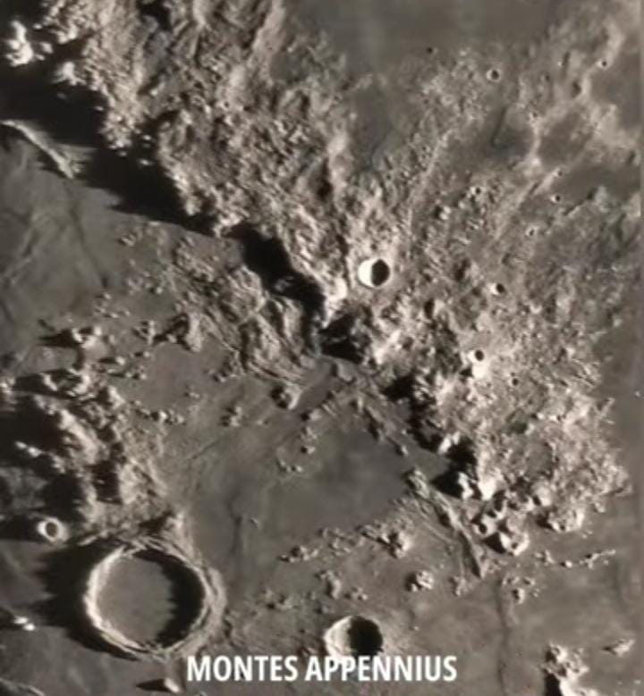
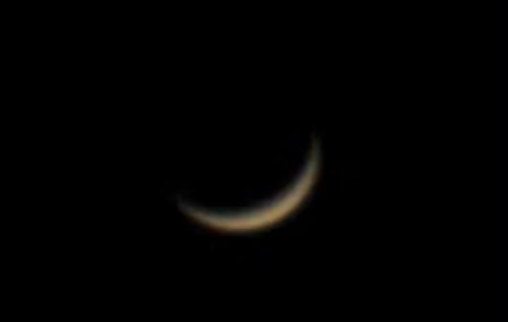
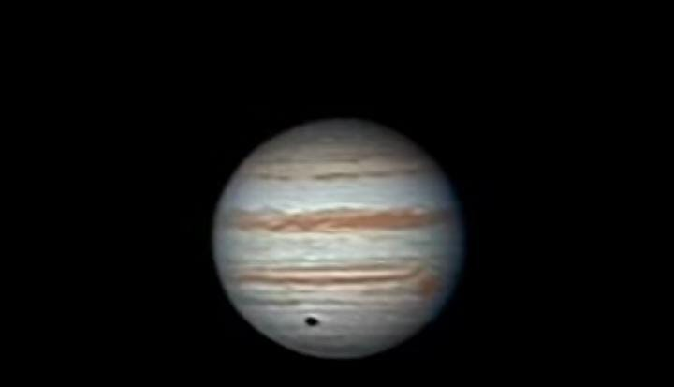
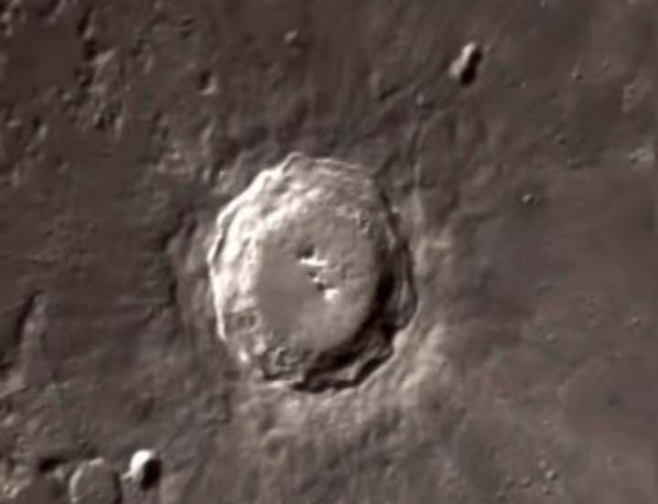
Images Captured by Cassegrain Telescope and its family
Saturn & it’s mighty ring
Montes Appennius
Mars with polar ice caps
Venus at crescent phase
Copernicus Crater
jupiter

Slide 13
Conclusion
The Cassegrain design plays a vital role in the formation of Modern Telescope in the modern World
Due to its long focal length the images are appeared as more contrast and clear to us as compared to refractive telescopes
The image contrast of Cassegrain Telescope mainly depends on its aperture if the size of the aperture is increased we can able to see the good contrast of images

Slide 14
Reference
Wilson, Raymond N. (2013). Reflecting Telescope Optics I
Cassegrain Telescope Wikipedia https://en.wikipedia.org/wiki/Cassegrain_reflector#References

Slide 15

Thank You
நன்றி

